Slide 1

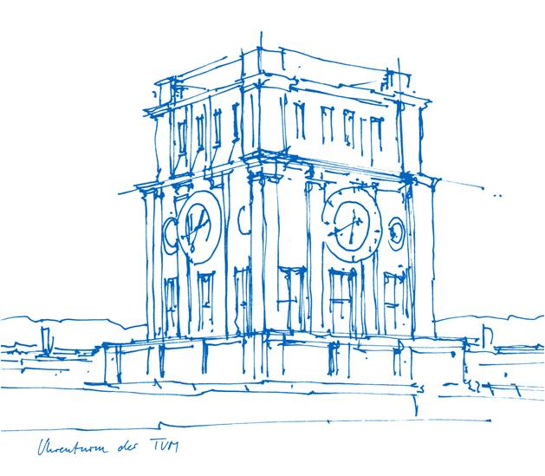
Project Teaser: Wired Plantar Pressure Measurement System (Footsole)
for Nodal Foot Sensing
Ahmed Abdeldayem, Francesco Orlandi, Isaiah Arias, Le My Linh
Clinical Applications of Computational Medicine (CAoCM)

Slide 2
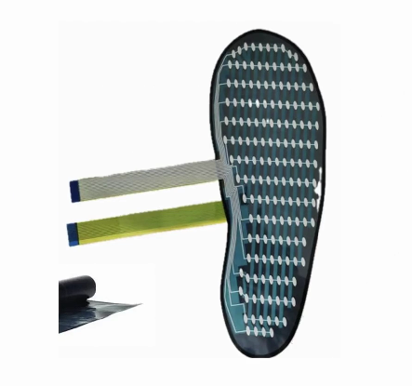
Problem Statement
Modern footwear, while providing protection, significantly alters the natural distribution of plantar pressure on our feet, and therefore our walking. Traditional rubber soles may mask the foot's sensory feedback and force-absorption capabilities, potentially leading to suboptimal movement patterns during high-impact activities. Current analysis oftens a lack of accessible, real-time data comparing these effects. This project utilizes a specialized sensor array to quantify the divergence between barefoot-mimicking mechanics with a leather sole and standard rubber-soled footwear

Slide 3
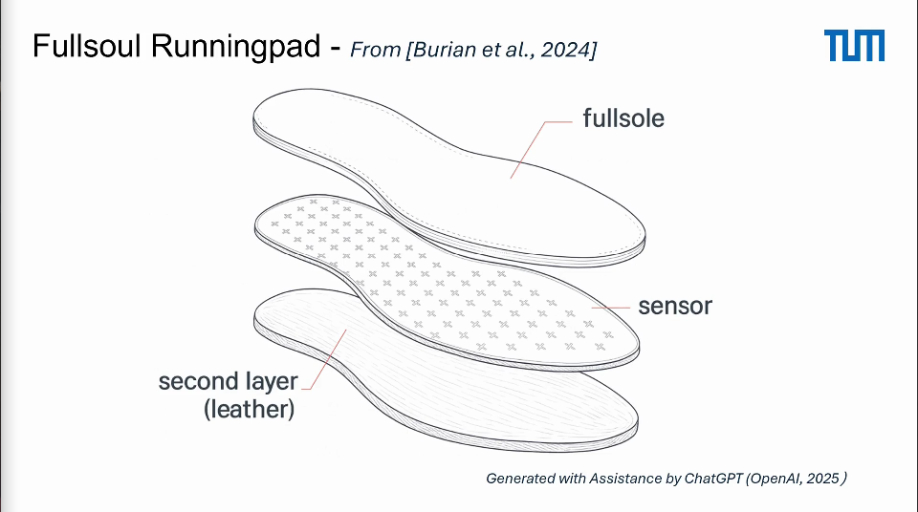
Structure

Slide 4
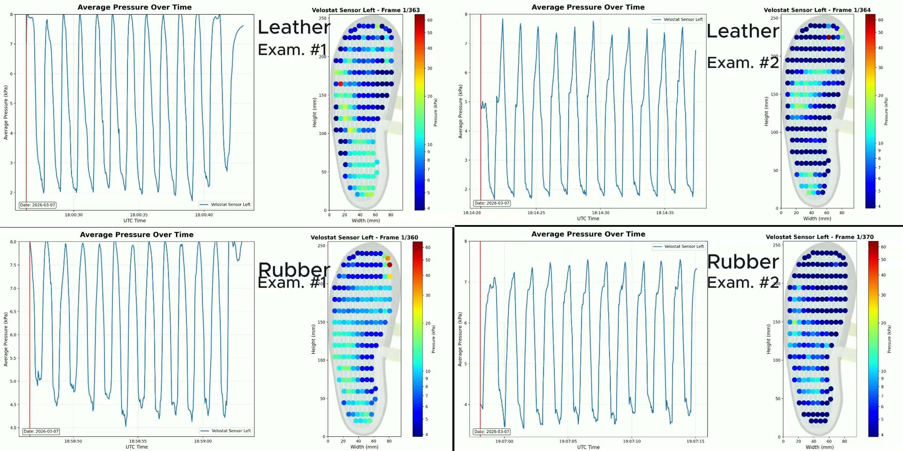

Slide 5
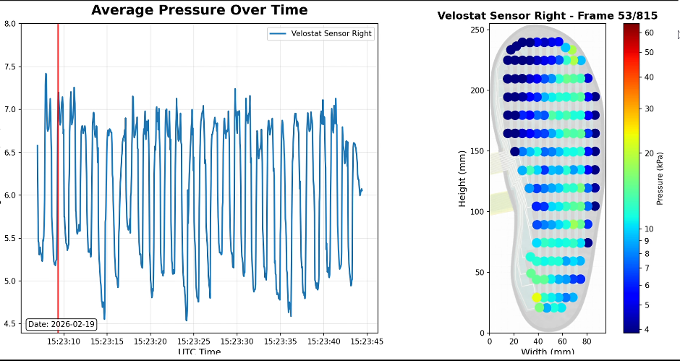
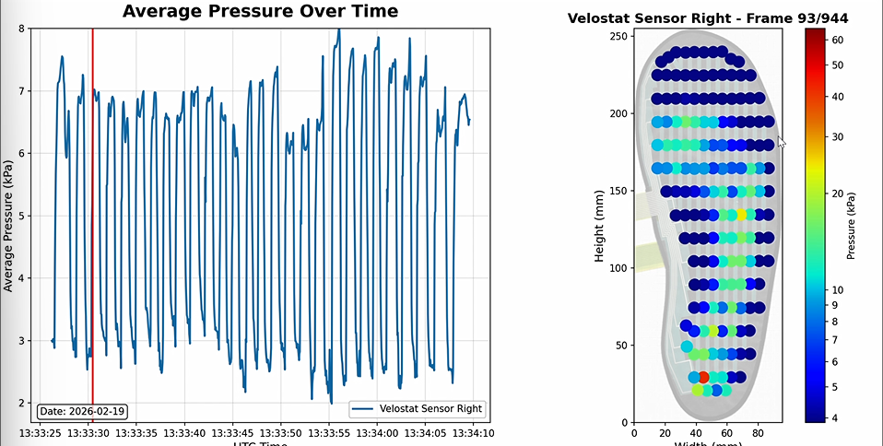
Insights
Rubber Sole
Leather Sole
As seen above the pressure variations upon the fourth oscillation show a curved (healthier) distribution of weight while using a leather sole verus with a rubber sole there is a significantly higher number of nodes being pressured resembling flat-footed walking.

Slide 6
Impact
By identifying that rubber soles correlate to a high distribution of "flat-footed" pressure, our results highlight a hidden risk factor for:
Plantar Fasciitis: Reducing the over-stressing of the foot's arch.
Over-pronation: Preventing the inward collapse of the foot that leads to knee and hip misalignment.
Muscle Atrophy: Encouraging the "leather-sole" curved distribution forces the small stabilizing muscles of the foot to engage, rather than becoming "lazy" in a rubber-cushioned environment.

